Slide 1
Research Opportunities at Trinity College
A Student’s Perspective
Jen Schackner
Trinity College IDP ‘15

Slide 2
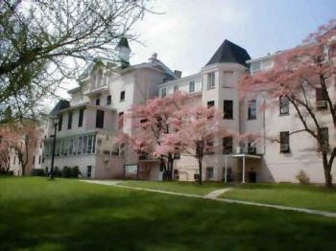

Internships for Credit

Slide 3
Collaborating with Professors
Creative
Research
Student Interests
Professors
Interests

Slide 4
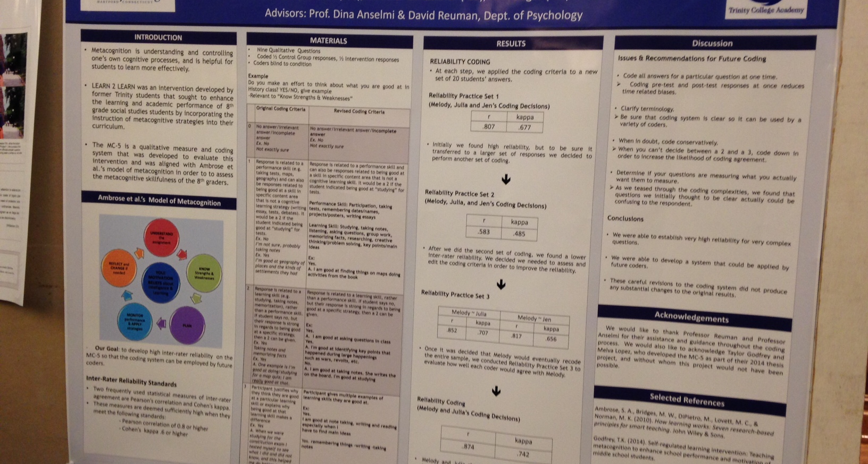
Summer Research Symposium

Slide 5
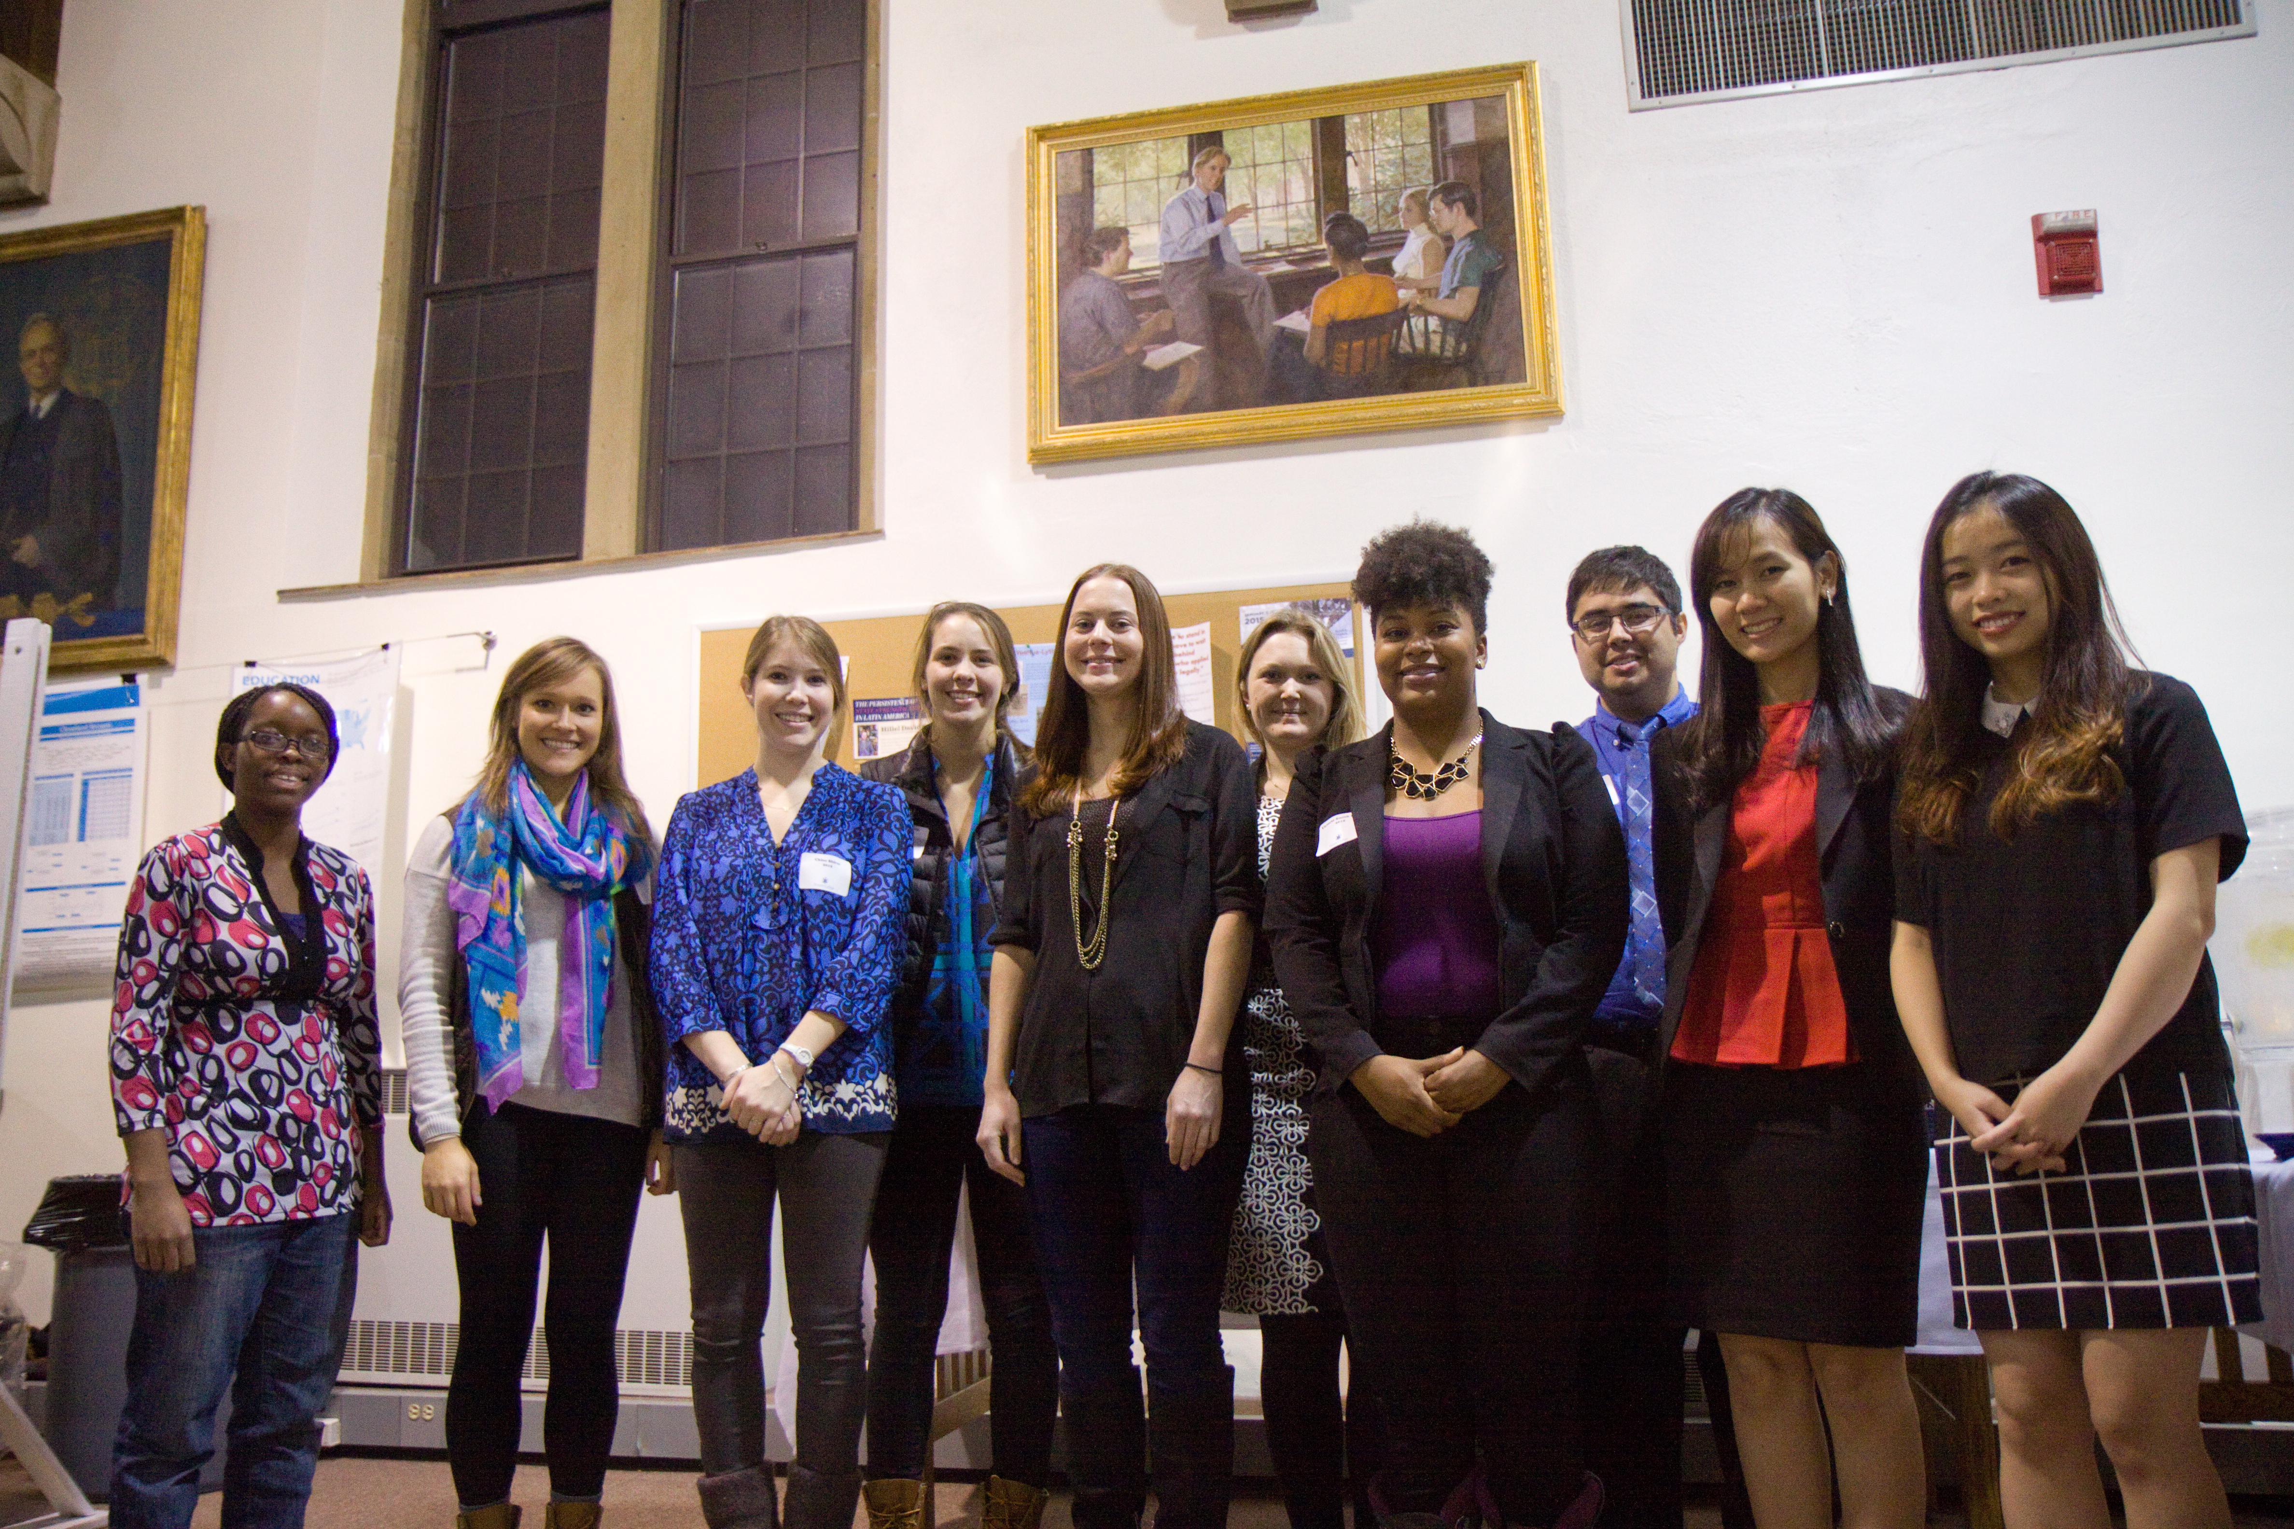
CLI Research Fellows

Slide 6
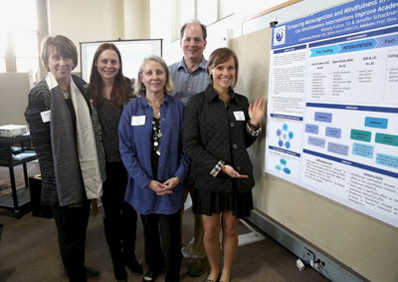
Senior Thesis

Slide 7
How has this enhanced my education?
Presentation Skills
Relationships with Trinity Faculty & Students
Educational Interests & Future Career Directions
*Allowed me to engage in topics I find important and meaningful*

Slide 8
Contact Info:
jennifer.schackner@trincoll.edu

